Slide 1
Brief overview of different Aero software architectures
ROLLS-ROYCE ELECTRICAL, SINGAPORE
Presenters: Wang Zihao

Slide 2
The importance of software architecture
Introduction
Software architecture refers to the fundamental structures of a software system and the discipline of creating such structures and systems, which consists of software elements, relations among them, and properties of both elements and relations.
There are several types of software architecture, which comprise different advantages and disadvantages, optimized for use in different scenarios.
Choosing an appropriate software architecture is of paramount importance in building successful software.

Slide 3
Good software architecture:
Introduction
Readability/Understandability
Maintainability
Scalability
Testability
Reliability/Robustness
Efficiency/Run time
Separation of concerns
Reusability

Slide 4
Overview
Aircraft_mission_tool_v3
Not object-oriented programming.
All code files are in one single folder.
No strict rules on how classes and their methods are stored in different python files.
\---src
aircraft_aerodynamics.py (classes)
aircraft_weight.py
battery.py
fuel_calculation.py
gas_turbine.py
global_names.py
input.py
interpolation.py
main.py
mission_analysis.py
paths.py
pms_logics.py
propeller.py
transmission.py

Slide 5
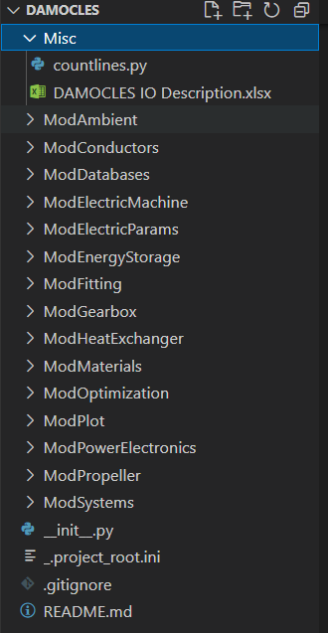
Overview
Code files are split based on conceptual categories such as ModAmbient, ModConductors, and ModDatabases.
DAMOCLES

Slide 6
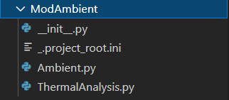
ModAmbient
DAMOCLES
File associated with Ambient are allocated in this folder.

Slide 7
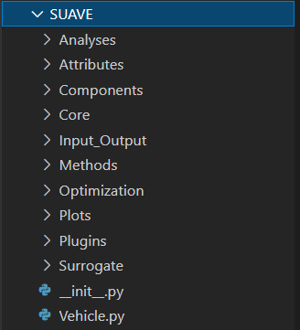
Overview
Code files are split into packages to give a clear separation between methods/functions and classes based on their functionalities/natures.
There are often parallel package trees inside the main branches of the package, for example there is Aerodynamics folder in both SUAVE.Methods and SUAVE.Analysis.
SUAVE

Slide 8
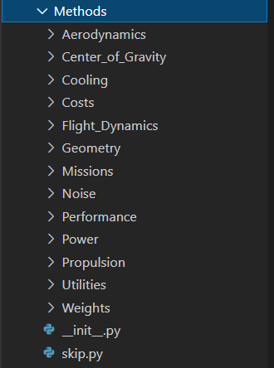
SUAVE.Methods: Low-level functions for data computation
SUAVE

Slide 9
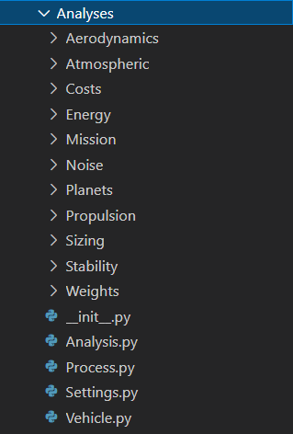
SUAVE.Analyses: High-level classes to perform analysis by calling functions from SUAVE.Methods
SUAVE

Slide 10
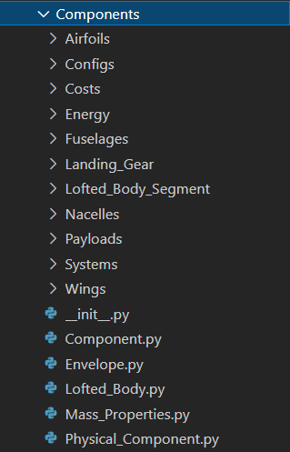
SUAVE.Components : Data storage containers for vehicle components, like a wing or landing gear
SUAVE

Slide 11
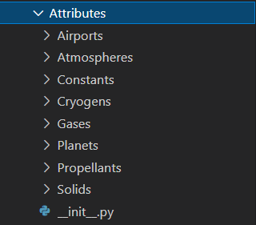
SUAVE.Attributes : Data storage containers for non-vehicle components, like atmospheres or water
SUAVE

Slide 12
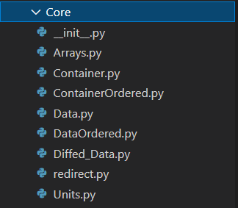
SUAVE.Core: Classes to handle data types and data structures
SUAVE

Slide 13
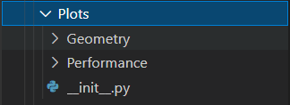
SUAVE.Plot: Functions to perform results visualization through plotting
SUAVE

Slide 14
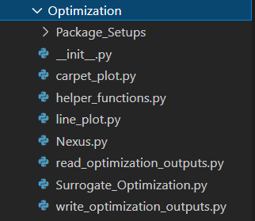
SUAVE.Optimization: High-level classes to obtain surrogate model to resolve optimization problems
SUAVE

Slide 15
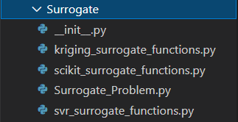
SUAVE.Surrogate: Low-level functions to build surrogate model based on different open source libraries
SUAVE

Slide 16
Layered (n-tier) architecture
SUAVE
Presentation layer (i.e., Interaction with users):
SUAVE.Plot.
Business layer (i.e., Execution of business logic as per the request):
SUAVE.Methods
SUAVE.Surrogate
Application layer (i.e., Media of communication between the ‘presentation layer’ and ‘data layer’):
SUAVE.Analyses
SUAVE.Optimization
Data layer (i.e., Database for data management):
SUAVE.Components
SUAVE.Attributes
SUAVE.Core
Reference: https://techbeacon.com/app-dev-testing/top-5-software-architecture-patterns-how-make-right-choice;https://www.geeksforgeeks.org/types-of-software-architecture-patterns/

Slide 17
SUAVE uses a layered (n-tier) architecture: The code is arranged so the data enters the top layer and works its way down each layer until it reaches the bottom. Along the way, each layer has a specific task, like performing computation on the data or reformatting the values to keep them consistent.
Advantage: Separation of concerns, maintainability, testability, reusability.
Disadvantage: Layer isolation makes it hard to understand the architecture without understanding every module (i.e., readability).
While DAMOCLES uses a peer-to-peer architecture (i.e., not entirely true, as the architecture used does not exactly fall into any type of software architecture): Individual components are called peers. A peer can act as a client (i.e., Request service from other peers), a server (i.e., Provide services to other peers), or both and change its role dynamically over time.
Advantage: Code understanding without understanding every module (i.e., readability).
Disadvantage: Maintainability, reusability, efficiency, robustness.
Comparison between SUAVE and DAMOCLES
Reference: https://www.simform.com/blog/software-architecture-patterns/

